Slide 1
SECURE DATA HIDING IN IMAGES USING STEGANOGRAPHY
CAPSTONE PROJECT
Presented By: Naga Abirami V
College Name & Department : Rajalakshmi engineering college & IT

Slide 2
OUTLINE
Problem Statement
Technology used
Wow factor
End users
Result
Conclusion
Git-hub Link
Future scope

Slide 3
Problem Statement
With the rise of digital communication, securing sensitive data is a major challenge. Traditional encryption methods can attract attention, making hidden data vulnerable. This project focuses on Secure Data Hiding in Images Using Steganography, ensuring confidentiality by embedding secret data within images while preserving their quality. The goal is to enhance security, imperceptibility, and robustness against detection or attacks, making it ideal for secure communication and data protection.

Slide 4
Technology used
Programming Language: Python 3.7.3
Libraries: OpenCV

Slide 5
Wow factors
High Security & Stealth – Embeds secret data within images without noticeable distortion, making it nearly undetectable.
Lossless Data Hiding – Ensures that both the image quality and the hidden data remain intact after extraction.
Lightweight & Efficient – Uses optimized Python and OpenCV-based algorithms for fast encoding and decoding.
Real-World Applications – Can be used for secure communication, watermarking, and digital forensics.

Slide 6
End users
Government & Defense Agencies – For secure communication and classified data exchange.
Cybersecurity Professionals – To protect sensitive information from unauthorized access.
Journalists & Whistleblowers – For safe transmission of confidential reports.
Corporate Organizations – To safeguard trade secrets and intellectual property.
Forensic Experts – For digital watermarking and evidence protection.
General Users – For personal data privacy and secure messaging

Slide 7
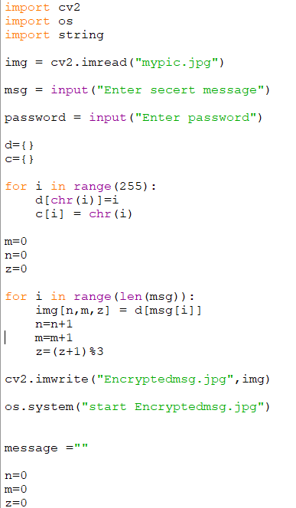
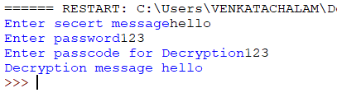
Results
OUTPUT

Slide 8
Conclusion
This project successfully implements Secure Data Hiding in Images Using Steganography, ensuring confidential data transmission while maintaining image quality. By leveraging Python and OpenCV, it offers a robust, efficient, and stealthy approach to secure communication. With applications in cybersecurity, defense, and digital forensics, it enhances privacy and data protection in the digital era.

Slide 9
GitHub Link
https://github.com/NagaAbirami1709/stenography.git

Slide 10
THANK YOU

